Slide 1
Process Creation
Lecture 09
[Stevens] Chap. 8
[Silberschatz] Sec. 3.3

Slide 2
The Goal
teach you how to write a job-control shell
  create and execute a program: Chap. 8
    fork(), exec() family
  basic synchronization: Chap. 8 and 10
    wait ()
    signal
  login terminal control: Chap. 9

Slide 3
Goal: Job control that a shell provides
piped job
  $> cat test.txt | enscript –p - | ps2pdf – test.pdf
background job and may submit multiple jobs
  $> make all > make.out &
  [1] 12345
  $> cat test.txt | enscript –p - | ps2pdf – test.pdf &
  [2] 12567
  $> vim README.txt
switch background job to foreground
  $> fg
keep execution after logout
  $> nohup make &
  $> logout

Slide 4
Basics about a process
what is a process
resources associated with a process
(concepts from the OS textbook)

Slide 5
What is a process
an instance of a executed program
  Demo: check “top” of an infinite loop program
  each process has its own process ID and allocated resources

Slide 6
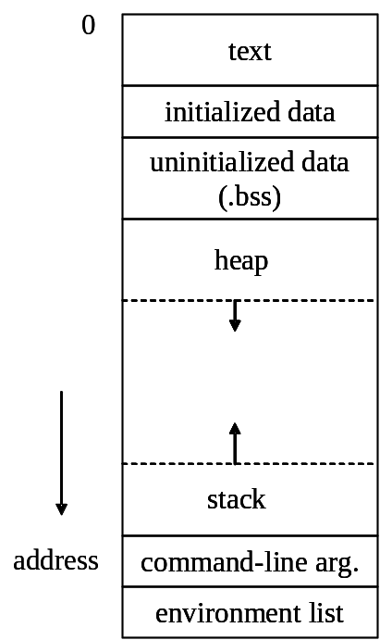
Resources of a process
separate virtual memory space
process control block (PCB)
PCB
process state
process number
program counter
registers
list of open files
…

Slide 7
Issues on creating a process
allocate resources and pass data to the created process
  create the address space and setup the content
  setup PCB
coordination between parent process and the child process
  Option 1: the parent process wait for termination of child process
  Option 2: the parent process runs in parallel with the child process

Slide 8
The UNIX approach to create a process
allocate resources and pass data to the created process
  copy the content of (almost) the whole address space and PCB
coordination between parent process and the child process
  Option 2: the parent process runs in parallel with the child process

Slide 9
Create a process and execute a program
overall flow of using system calls fork(), wait(), and exec family

Slide 10
Scheme to create a new process and execute a desired program
Parent Process
(shell)
Child Process
fork ()
execxxx(“a.out”, ...);
a.out
time
wait ()

Slide 11
Scheme to create a new process and execute a desired program
The fork() system call to create a new process
Parent Process
(shell)
Child Process
fork ()
execxxx(“a.out”, ...);
a.out
time
wait ()

Slide 12
Scheme to create a new process and execute a desired program
call a function of the exec family to replace the memory content with a image file
Parent Process
(shell)
Child Process
fork ()
execxxx(“a.out”, ...);
a.out
time
wait ()

Slide 13
Scheme to create a new process and execute a desired program
Parent Process
(shell)
Child Process
fork ()
execxxx(“a.out”, ...);
a.out
time
wait for the child process terminates
wait ()

Slide 14
The fork() system call

Slide 15
The UNIX approach to create a process
allocate resources and pass data to the created process
  copy the content of (almost) the whole address space and PCB
coordination between parent process and the child process
  Option 2: the parent process runs in parallel with the child process

Slide 16
How to create a new process?
fork and generate a process with identical content
Parent Process
Child Process
pid = fork ();
if (pid==0) {//child process
execlp (filename, filename, (void*)0);
printf (“Error if you see this line\n”);
}
else { //parent process
printf (“This is in parent process\n”);
}
pid = fork ();
if (pid==0) {//child process
execlp (filename, filename, (void*)0);
printf (“Error if you see this line\n”);
}
else { //parent process
printf (“This is in parent process\n”);
}
fork
identical copy to the parent process

Slide 17
How to create a new process? (cont’d)
But different PID results in different execution path
Parent Process
Child Process
pid = fork ();
if (pid==0) {//child process
execlp (filename, filename, (void*)0);
printf (“Error if you see this line\n”);
}
else { //parent process
printf (“This is in parent process\n”);
}
pid = fork ();
if (pid==0) {//child process
execlp (filename, filename, (void*)0);
printf (“Error if you see this line\n”);
}
else { //parent process
printf (“This is in parent process\n”);
}
Program Counter

Slide 18
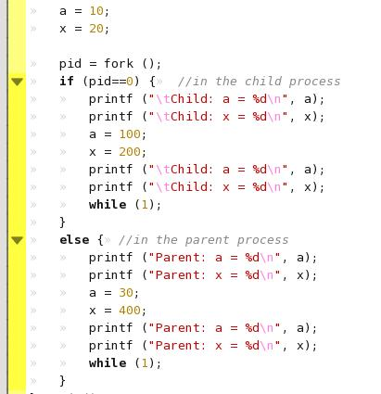
Demo: fork
to show you that fork() creates a process with identical memory content

Slide 19
Demo: fork
to show you that fork() creates a process with identical memory content
Child process
Parent process

Slide 20
Demo: fork
to show you that fork() creates a process with identical memory content
initial data will be
the same

Slide 21
Demo: fork
to show you that fork() creates a process with identical memory content
different data after
execution

Slide 22
Demo: fork
check “top” to verify that there are two separate processes!

Slide 23
The exec family system calls

Slide 24
The UNIX approach to create a process
allocate resources and pass data to the created process
  copy the content of (almost) the whole address space and PCB
  but you can change the whole memory content with “exec” family system call after process started
coordination between parent process and the child process
  Option 2: the parent process runs in parallel with the child process

Slide 25
Scheme to create a new process and execute a desired program
Parent Process
(shell)
Child Process
fork ()
execxxx(“a.out”, ...);
a.out
time
wait ()

Slide 26
Scheme to create a new process and execute a desired program
call a function of the exec family to replace the memory content with a image file
Parent Process
(shell)
Child Process
fork ()
execxxx(“a.out”, ...);
a.out
time
wait ()

Slide 27
How to create a process and execute a desired program
自毀而後重生

Slide 28
How to create a new process?
fork and generate a process with identical content
Parent Process
Child Process
pid = fork ();
if (pid==0) {//child process
execlp (filename, filename, (void*)0);
printf (“Error if you see this line\n”);
}
else { //parent process
printf (“This is in parent process\n”);
}
pid = fork ();
if (pid==0) {//child process
execlp (filename, filename, (void*)0);
printf (“Error if you see this line\n”);
}
else { //parent process
printf (“This is in parent process\n”);
}
fork
identical copy to the parent process

Slide 29
How to create a new process? (cont’d)
But different PID results in different execution path
Parent Process
Child Process
pid = fork ();
if (pid==0) {//child process
execlp (filename, filename, (void*)0);
printf (“Error if you see this line\n”);
}
else { //parent process
printf (“This is in parent process\n”);
}
pid = fork ();
if (pid==0) {//child process
execlp (filename, filename, (void*)0);
printf (“Error if you see this line\n”);
}
else { //parent process
printf (“This is in parent process\n”);
}
Program Counter

Slide 30
How to create a new process? (cont’d)
The child process executes an exec() system call to refill its content
Child Process
pid = fork ();
if (pid==0) {//child process
execlp (filename, filename, (void*)0);
printf (“Error if you see this line\n”);
}
else { //parent process
printf (“This is in parent process\n”);
}
main(){
printf (“I am the new program\n”);
return 0;
}
exec

Slide 31
exec family functions
functions to load an executable file as memory image
and start execution with command-line parameters
the system call is: execve()

Slide 32
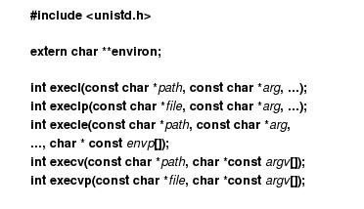
exec family functions
the man page

Slide 33
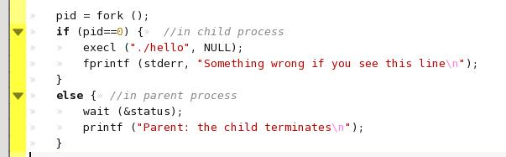
Demo: fork_exec
fork a new process,
and execute the program hello

Slide 34
Demo: fork_exec
fork a new process,
and execute the program hello
load the program image from file “./hello”
and execute

Slide 35
The wait () system call

Slide 36
The UNIX approach to create a process
allocate resources and pass data to the created process
  copy the content of (almost) the whole address space and PCB
coordination between parent process and the child process
  Option 2: the parent process runs in parallel with the child process
  but you can force the parent process to wait with “wait()” system call

Slide 37
Scheme to create a new process and execute a desired program
Parent Process
(shell)
Child Process
fork ()
execxxx(“a.out”, ...);
a.out
time
wait ()

Slide 38
Scheme to create a new process and execute a desired program
Parent Process
(shell)
Child Process
fork ()
execxxx(“a.out”, ...);
a.out
time
wait for the child process terminates
wait ()

Slide 39
System calls
wait (*status)
  wait the state change of any child process
  *status: to store the state of the child process
waitpid (pid, *status, options)
  wait state change for specific child process specified by process ID (pid)
Please “man wait” for detail!

Slide 40
Demo: fork_exec
fork a new process,
and execute the program hello
wait for the child process terminates

Slide 41
A short summary and the next step
basic scheme of fork and execute a program DONE
  use of fork(), exec family, and wait() system calls
Q: what if the shell (parent process) want to do more control over the child?
  redirect output stream
  setup startup status with synchronization

Slide 42
Example 1: setup initial status after fork
the “fork and redirect” example
to show how to setup resources allocated to a process

Slide 43
The UNIX approach to create a process
allocate resources and pass data to the created process
  copy the content of (almost) the whole address space and PCB
  but you can still re-allocate the resources with careful programming
coordination between parent process and the child process
  Option 2: the parent process runs in parallel with the child process

Slide 44
Demo: fork_redirect
write a program that execute a given command and redirect the terminal output to a file
  the redirect functionality of shell
    ls –l > file_list.txt
the demo program fork_redirect
  fork_redirect hello
  fork_redirect /bin/cat hello.c
  the execution result will be redirected to “output_file.txt”

Slide 45
How to do fork_redirect?
How a program writes to a terminal
What data that the OS maintain for a process (PCB: Process Control Block)
How to setup initial status after a process startup

Slide 46
Review: What “open” does?
How UNIX manages opened files and I/O devices for a process
memory
disk
process table entry
fd
flags
file
pointor
inode
fd 0
file table
fd 1
fd 2
status flags
…
offset
…
inode ptr.

Slide 47
Review: How a UNIX program controls I/O device?
main ()
{
…
fd = open (“/dev/tty1”,…);
write (fd, …);
…
}
access like a file
file system
…
/dev/tty1
/dev/hda1
…
driver of
/dev/tty1
driver of
/dev/hda1
intercept to do I/O
UNIX kernel

Slide 48

How “printf” sends out its string?
fork sets up the process table entry as the parent process (the shell)
file descriptor 0, 1, 2 refers to STDOUT_FILENO, STDIN_FILENO, and STDERR_FILENO
try ls –l /dev/tty* or /dev/pts/*
main ()
{
…
printf (“Hello!\n”);
…
}
printf (…)
{
…
write (0, …/* “Hello” */);
…
}
process table entry
fd
flags
file
pointor
fd 0
fd 1
fd 2
…
…

Slide 49
How to redirect “printf”?
let STDOUT_FILENO points to the target file
system call dup, dup2
main ()
{
…
printf (“Hello!\n”);
…
}
printf (…)
{
…
write (0, …/* “Hello” */);
…
}
process table entry
fd
flags
file
pointor
fd 0
fd 1
fd 2
…
target
file
…

Slide 50
Steps to fork a process with I/O redirection
child process
shell ()
{
…
pid = fork (…);
if (pid is child) {
fd_target = open(target_file);
set STDOUT_FILENO as fd_target; //dup2
exec (“a.out”, …);
}
else (pid is parent) {
…
}
}
process table entry
fd
flags
file
pointor
fd 0
fd 1
fd 2
…
target
file
…

Slide 51
Steps to fork a process with I/O redirection
child process
shell ()
{
…
pid = fork (…);
if (pid is child) {
fd_target = open(target_file);
set STDOUT_FILENO as fd_target; //dup2
exec (“a.out”, …);
}
else (pid is parent) {
…
}
}
process table entry
fd
flags
file
pointor
fd 0
fd 1
fd 2
…
target
file
…

Slide 52
Steps to fork a process with I/O redirection
child process
main ()
{
…
printf (“Hello!\n”);
…
}
printf (…)
{
…
write (0, …/* “Hello” */);
…
}
process table entry
fd
flags
file
pointor
fd 0
fd 1
fd 2
…
target
file
…

Slide 53
Example 2: setup initial status
fork and send data through FIFO

Slide 54
What the demo fork_fifo does?
Parent process:
  1. fork a child process
  2. create a fifo “test.fifo”
  3. send a string to child through “test.fifo”
Child process:
  read a string from “test.fifo”
Q: How to ensure that the child process reads “test.fifo” after the parent creates it?

Slide 55
Startup synchronization for the demo fork_fifo
Parent Process
Child Process
fork ()
mkfifo ()
while (flag);
kill ()
flag = 0;
test.fifo
sender ()
receiver ()
time
FINISH
wait ()
FINISH

Slide 56
Startup synchronization for the demo fork_fifo
Parent Process
Child Process
busy waiting
(flag is initailed to 1)
fork ()
mkfifo ()
while (flag);
kill ()
flag = 0;
test.fifo
sender ()
receiver ()
time
FINISH
wait ()
FINISH

Slide 57
Startup synchronization for the demo fork_fifo
Parent Process
Child Process
create the fifo
fork ()
mkfifo ()
while (flag);
kill ()
flag = 0;
test.fifo
send signal after
the fifo created
sender ()
receiver ()
time
the signal handler release the flag
FINISH
wait ()
FINISH

Slide 58
Startup synchronization for the demo fork_fifo
Parent Process
Child Process
fork ()
mkfifo ()
while (flag);
kill ()
flag = 0;
test.fifo
sender ()
receiver ()
time
FINISH
the child always reads the fifo after created
wait ()
FINISH

Slide 59
Next Lecture
How to make a process get terminal control privilege
  Chap. 9

